Slide 1
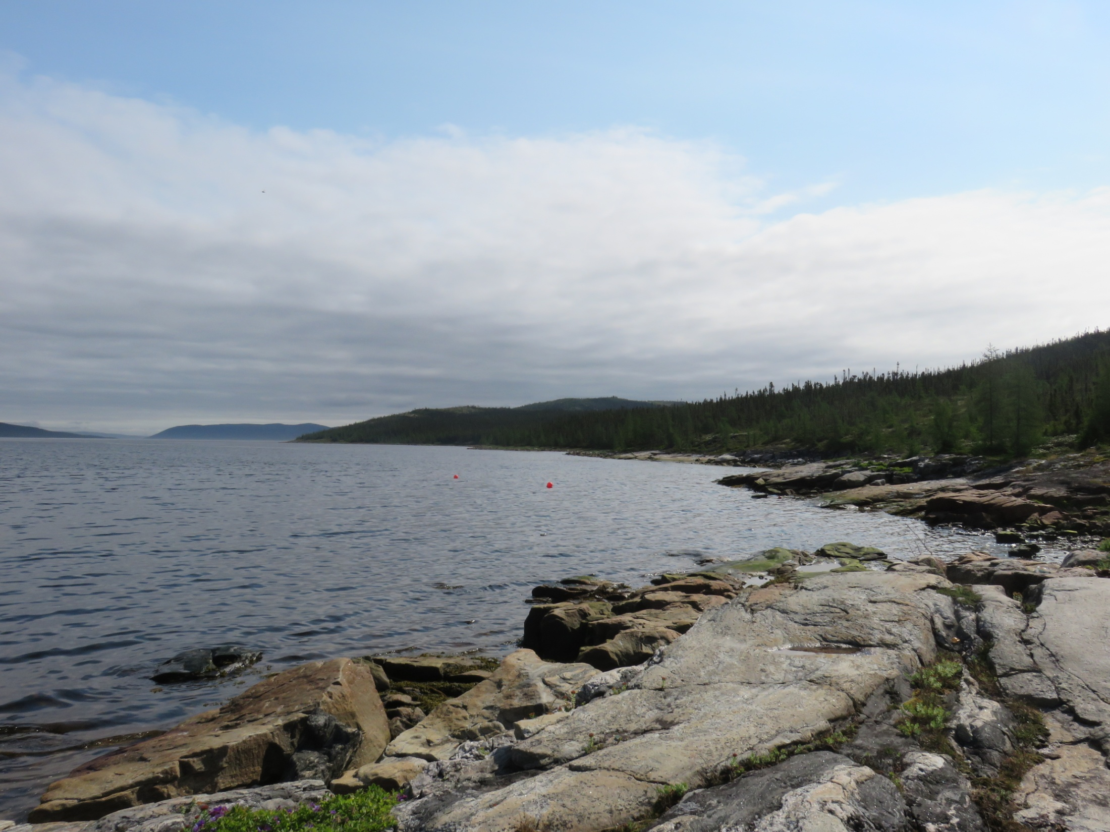
Participatory methods in Rigolet:
Evaluation of Inuit health programs and collaborative development of a whiteboard video for health promotion
Presenters: Inez Shiwak & Manpreet Saini
Authors: Manpreet Saini, Inez Shiwak, Steven Roche, Andrew Papadopoulos, Michele Wood, Rigolet Inuit Community Government, Nunatsiavut Government, IHACC Research Team and Sherilee Harper

Slide 2
Outline
Background
  Inuit Health: Acute Gastrointestinal Illness (AGI) in Rigolet
  Whiteboard Videos
Goals & Objectives
Methods
Preliminary Results
Next Steps

Slide 3
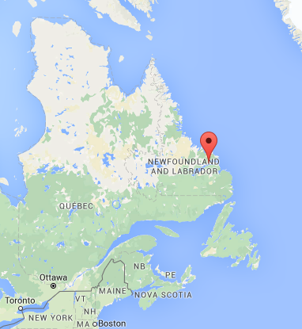
Inuit Health: AGI in Rigolet
Background
Goals & Objectives
Methods
Preliminary Results
Next Steps
Acknowledgements
Rigolet
  Located in Nunatsiavut
  North coast of Labrador
  Population of ~ 300
AGI
Associated with acute diarrhea and/or vomiting
Rates of AGI
  Rigolet: 2.2 - 2.7 cases per person per year
  Across Canada: 0.7 - 1.3 cases per person per year
References:
Harper, S.L. , Edge, V., & Willox, A. (2012). 'Changing Climate, Changing Health, Changing Stories’ Profile: Using an EcoHealth Approach to Explore Impacts of Climate Change on Inuit Health. EcoHealth,9, 89-101.
Harper, S.L. 2013. Gastrointestinal Illness in Canada’s North: Implications of Climate Change on Current and Future Inuit Health. PhD Thesis. Department of Population Medicine, University of Guelph, Guelph, ON.
Welcome to Rigolet. (2012). Retrieved January 7, 2015, from http://www.townofrigolet.com/home/home.htm

Slide 4
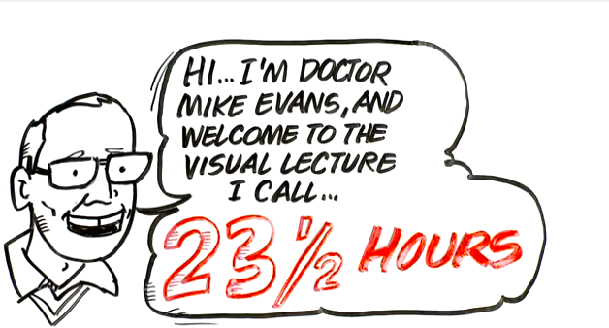

Whiteboard Videos
Background
Goals & Objectives
Methods
Preliminary Results
Next Steps
Acknowledgements
Whiteboard scribing videos with an overlaying narrative
  Appropriate for the oral/visual culture of Inuit
Messages are easy to follow and understand
Examples:
YouTube Channel: DocMikeEvans
YouTube Channel: AsapSCIENCE

Slide 5
Goals & Objectives
Background
Goals & Objectives
Methods
Preliminary Results
Next Steps
Acknowledgements
Co-develop a whiteboard video with Inuit youth and community members to share public health information
Co-develop an evaluation framework for Inuit health programs using participatory methods
Assess the development and use of the video using the evaluation framework

Slide 6
In-depth Interviews
Background
Goals & Objectives
Methods
Preliminary Results
Next Steps
Acknowledgements
Interviewees
  Rigolet community members (n= 18)
  Government employees (n= 3)
Topics of discussion
  Participation of community members in public health program evaluation
  Whiteboard video feedback and input

Slide 7
Focus Groups
Background
Goals & Objectives
Methods
Preliminary Results
Next Steps
Acknowledgements
3 focus groups discussions in Rigolet
  One with 6 community members
  Two with 3 and 4 government employees
Topics of discussion
  Participation of community members in public health program evaluation
  Whiteboard video feedback and input

Slide 8
Youth Workshop
Background
Goals & Objectives
Methods
Preliminary Results
Next Steps
Acknowledgements
3 Day Workshop
  3 boys and 3 girls aged 11 – 13 years old
Day 1
Youth shown a whiteboard video
Day 2
Cameras were returned
Day 3
Ideas provided during community open house were discussed
Role play exercise
Camera distribution
Youth provided input on the script
They developed the character
Using their photos and ideas, a storyboard was developed

Slide 9
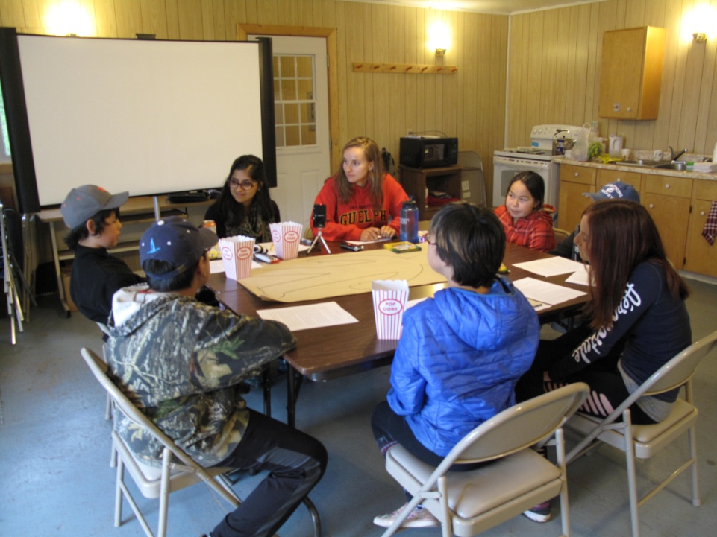
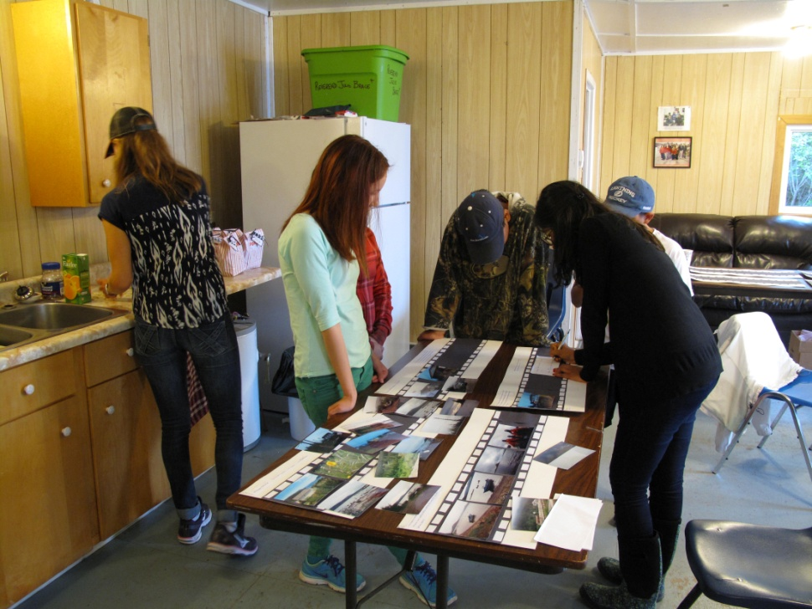
Youth Workshop
Background
Goals & Objectives
Methods
Preliminary Results
Next Steps
Acknowledgements
Photo Credit: Inez Shiwak
Photo Credit: Inez Shiwak

Slide 10
Community Open House
Background
Goals & Objectives
Methods
Preliminary Results
Next Steps
Acknowledgements
Three stations:
  What is a whiteboard video?
  What have the youth been working on?
  Survey
      Provided feedback on:
        Health information seeking behaviour
        Whiteboard video feedback and ideas

Slide 11
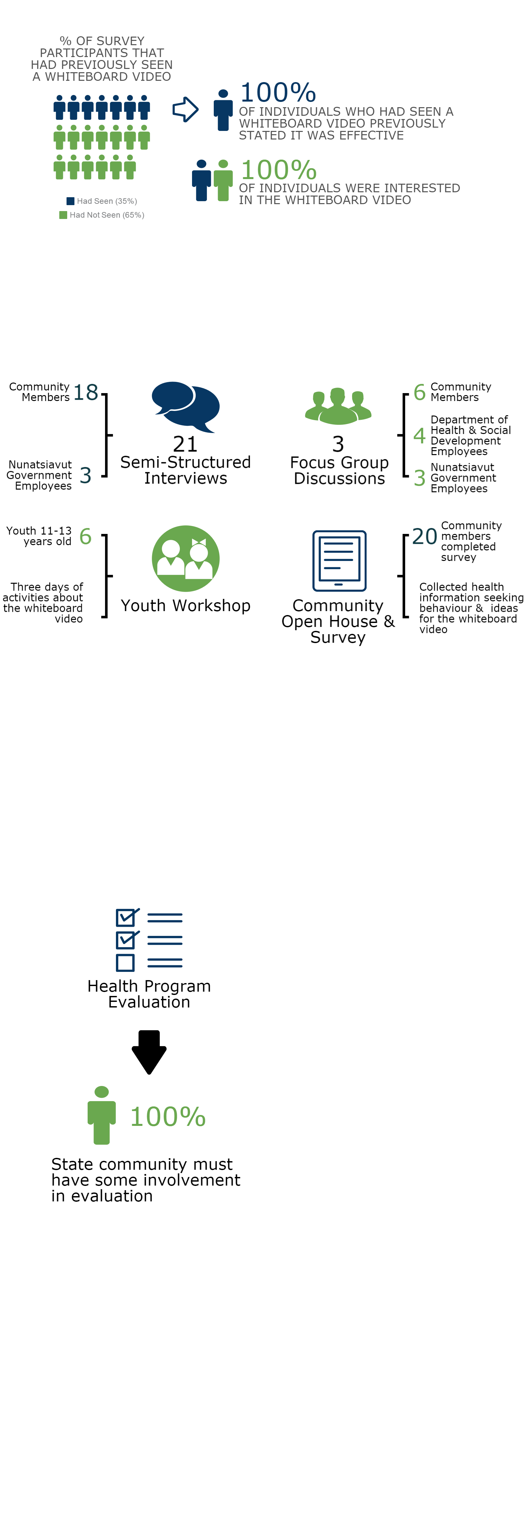
Preliminary Results
Background
Goals & Objectives
Methods
Preliminary Results
Next Steps
Acknowledgements
Surveys:

Slide 12
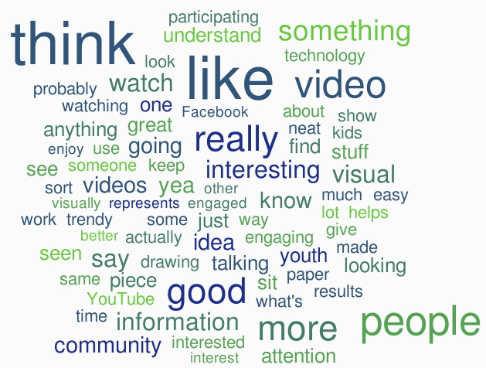
Preliminary Results
Background
Goals & Objectives
Methods
Preliminary Results
Next Steps
Acknowledgements
Interview and focus group participants expressed positive responses (e.g. “like”, “interesting”, “good”) to the whiteboard video

Slide 13
Preliminary Results
Background
Goals & Objectives
Methods
Preliminary Results
Next Steps
Acknowledgements
Evaluation Framework

Slide 14
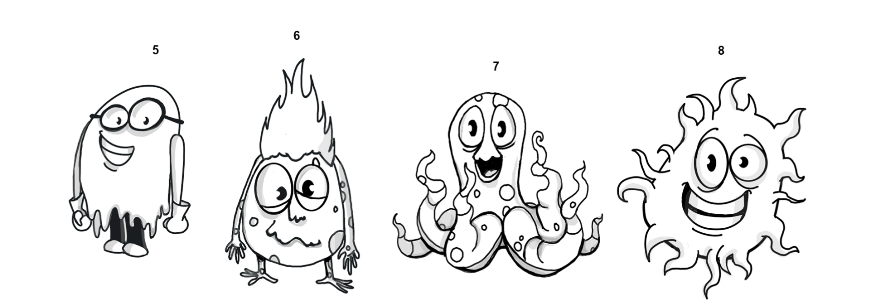
Whiteboard Video Production
Background
Goals & Objectives
Methods
Preliminary Results
Next Steps
Acknowledgements
On-going communication with community members and youth
Local voice for narration
Artist developing images

Slide 15
Next Steps
Background
Goals & Objectives
Methods
Preliminary Results
Next Steps
Acknowledgements
Develop Participatory Evaluation Plan
Present the Video to the Community
Evaluation of the Video and its Development Process

Slide 16





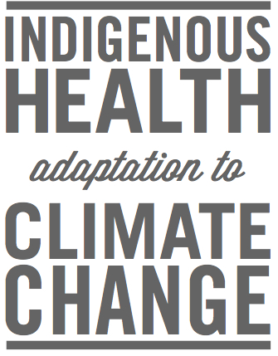
Acknowledgements
Background
Goals & Objectives
Methods
Preliminary Results
Next Steps
Acknowledgements
Youth in Rigolet: Rodney, Alison, Mackenzie, Brittney, Ryan and Brady
Rigolet community members
Nia King
Funders: the Nasivvik Centre for Inuit Health and Changing Environments, IDRC, CIHR, SSHRC, NSERC and the Indigenous Health Adaptation to Climate Change and Arthur D. Latornell

